Slide 1


SAP OData Training
Day - 9.

Slide 2


Agenda Day - 9
Describing SAP Analytics Cloud ( SAC )
Consume CDS in Analytics Cloud
Creating Dashboard’s on top of CDS in Analytics Cloud
Break
Service Generation Technique
Build OData with SG Technique
Implementing C-R-U-D
Test OData in GW Client
Trainer: Anubhav Oberoy

Slide 3
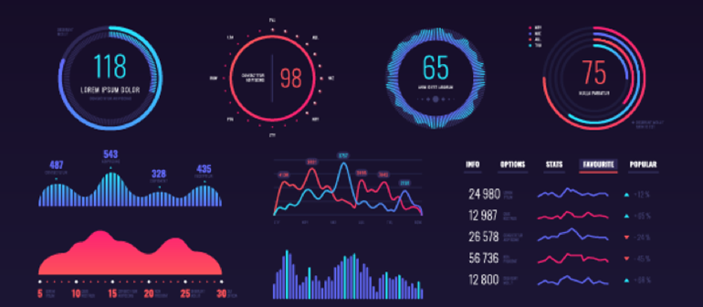
SAP Analytics Cloud ( SAC )
The SAP Analytics Cloud solution combines BI, augmented and predictive analytics, and planning capabilities into one cloud environment. As the analytics layer of SAP's Business Technology Platform, it supports advanced analytics enterprise-wide.
SAP Analytics cloud is a SaaS offering by SAP for complete BI, Planning, Predictive and designer capabilities.
Introduction
01
02
Hardware Innovation
Trainer: Anubhav Oberoy

Slide 4
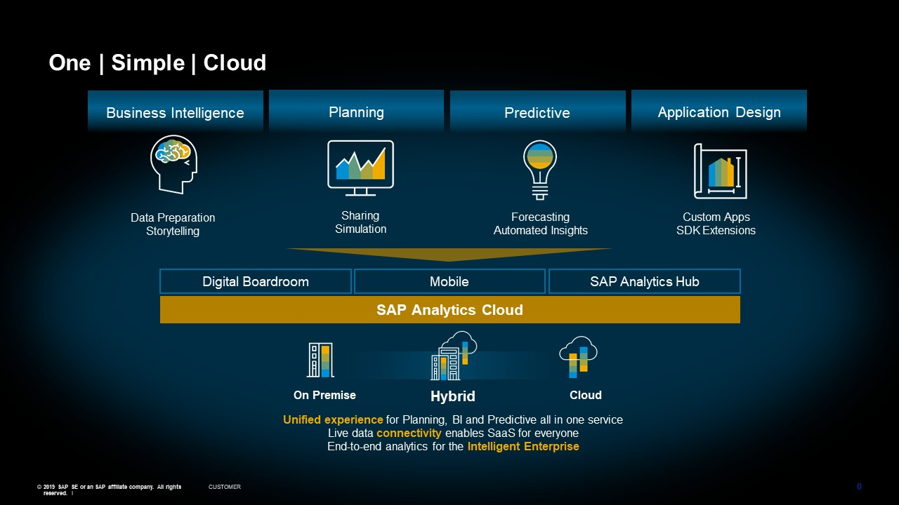
Phases of SAP Analytics Cloud ( SAC )
Introduction
01
Software Innovation
02
Hardware Innovation
Trainer: Anubhav Oberoy

Slide 5

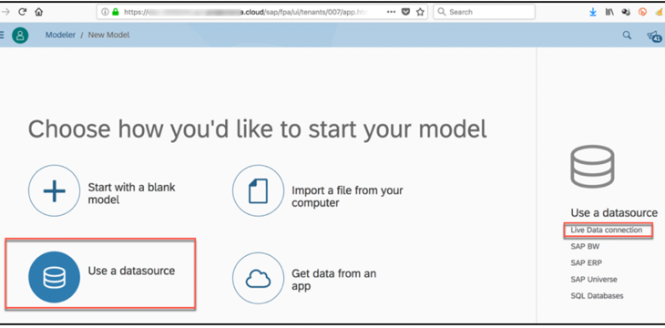
Consume CDS in Analytic Cloud
Exercise
CDS View for Analytics
Introduction
01
Software Innovation
With Live Data
Connection
02
Hardware Innovation
Trainer: Anubhav Oberoy

Slide 6
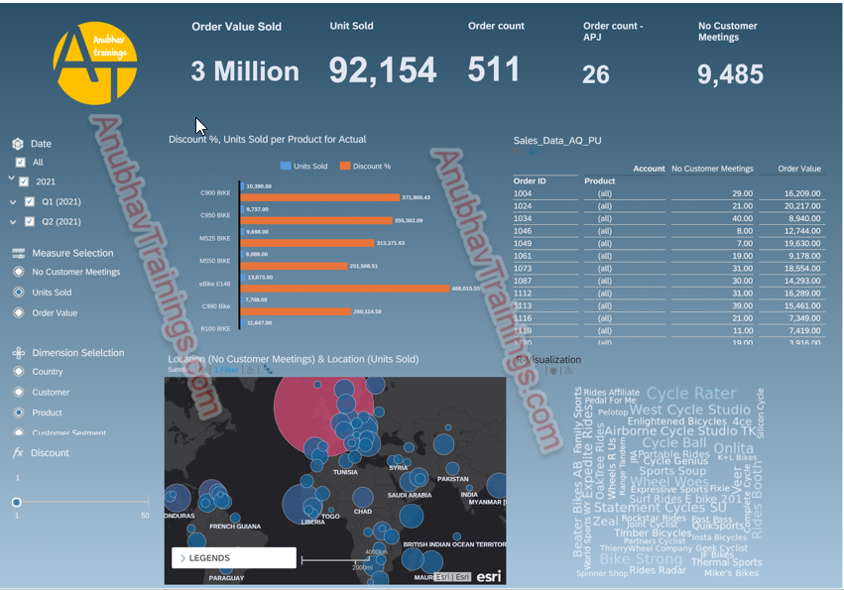
SAC Dashboard on top of CDS
Introduction
01
02
Hardware Innovation
Trainer: Anubhav Oberoy

Slide 7

Break

Slide 8
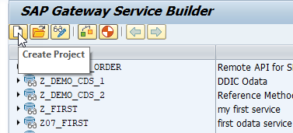
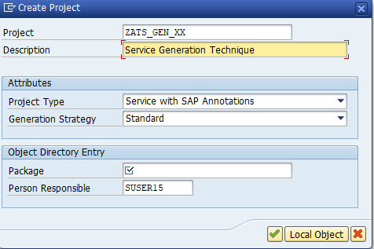
Service Generation Technique
In Service Generation Technique (Mapping Data Source) Create OData Service with Function Model’s or BAPI’S, Go to SEGW and Create Service
Introduction
Step 1. In SEGW Tcode Click On Create Project.
01
Step 2. Assign Project Name and Create OData
Trainer: Anubhav Oberoy

Slide 9
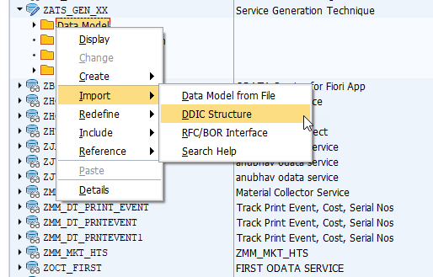
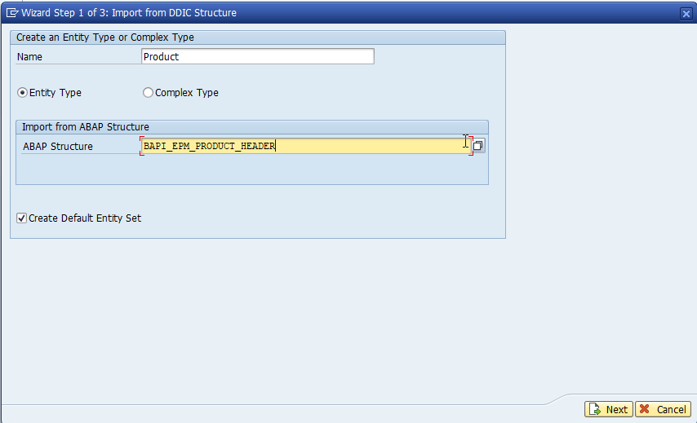
Service Generation Technique
Step 3. Right Click On Data Model and Select DDIC Structure.
Step 4. Give Name of Entity “Product” , Assign ABAP Structure “BAPI_EPM_PRODUCT_HEADER”.
Introduction
01
02
Trainer: Anubhav Oberoy

Slide 10
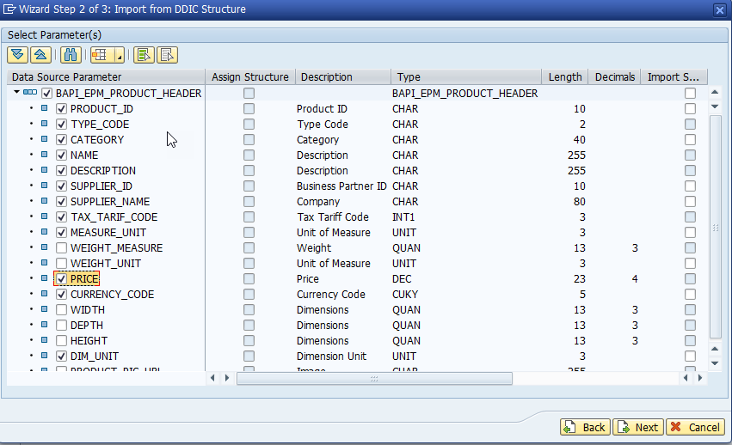
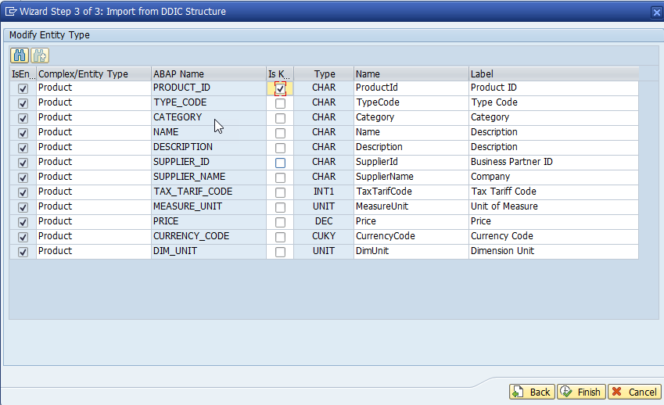
Service Generation Technique
Step 5. Select Fields properties for Entity Type and Click on Next.
Step 6. Select Primary Key and Click On Finish.
Introduction
01
Software Innovation
02
Trainer: Anubhav Oberoy

Slide 11
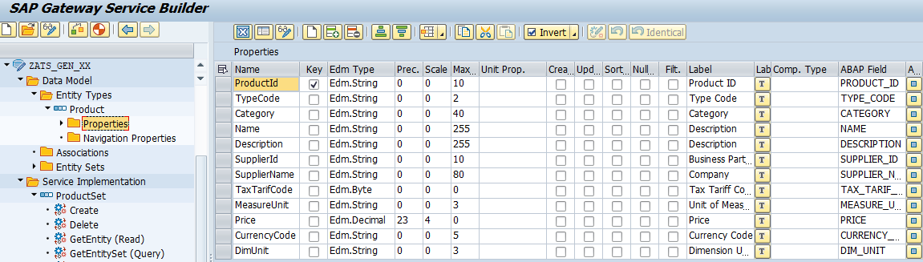
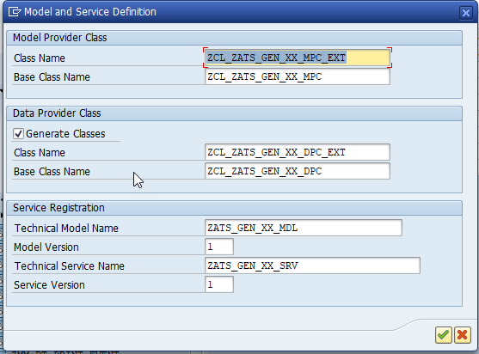
Service Generation Technique
Introduction
Step 7. Generate the Service.
01
02
Trainer: Anubhav Oberoy

Slide 12
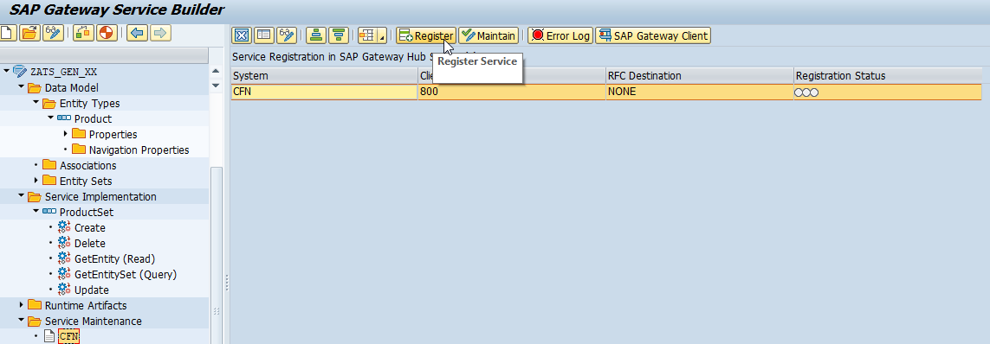
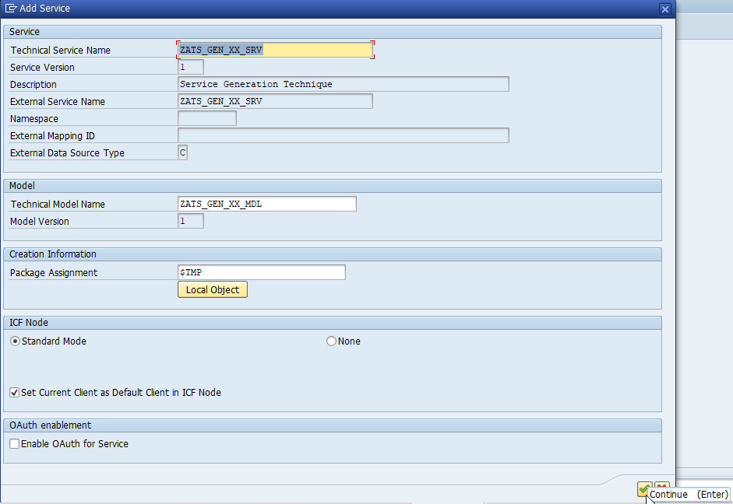
Service Generation Technique
Introduction
Step 8. Go to Service Maintenance Click on Register and Our OData Service is Successfully Registered .
01
Software Innovation
02
Hardware Innovation
Trainer: Anubhav Oberoy

Slide 13
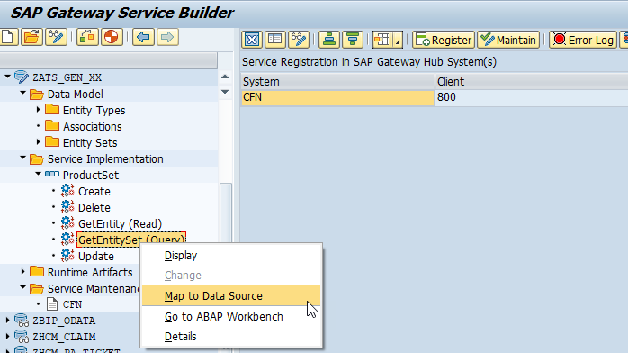
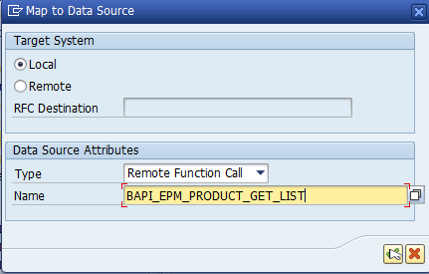
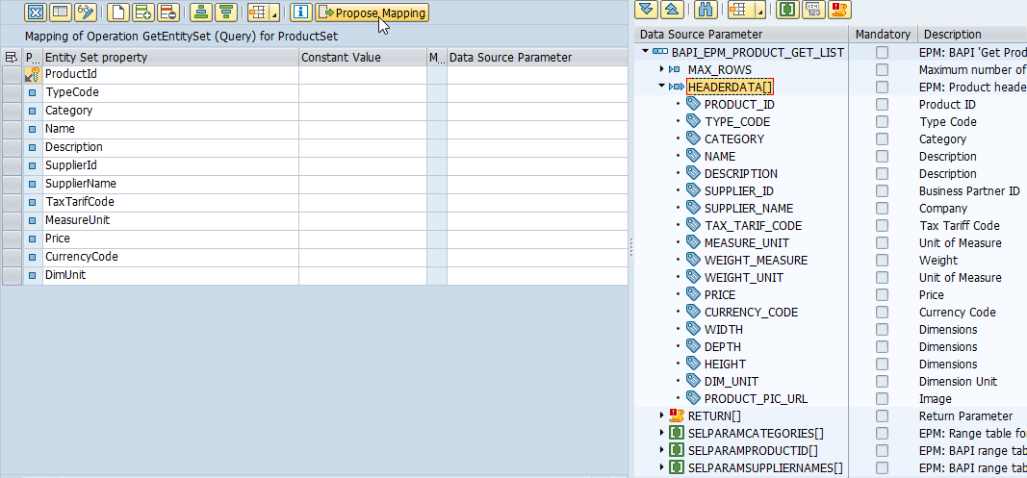
Building Get EntitySet Method
Introduction
01
02
Hardware Innovation
Trainer: Anubhav Oberoy

Slide 14
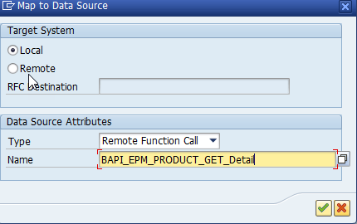
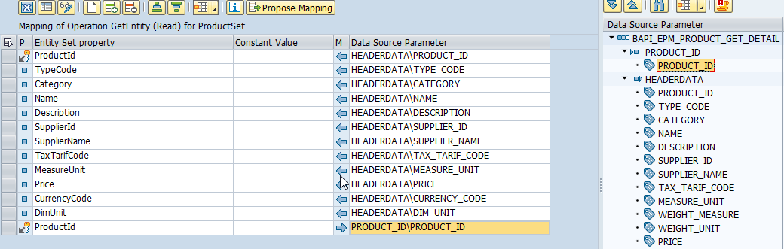
Building Get Entity Method (Single Record )
“BAPI_EPM_PRODUCT_GET_DETAILS” Use for Single Entity.
01
Software Innovation
02
Hardware Innovation
Trainer: Anubhav Oberoy

Slide 15
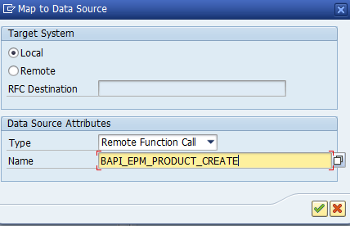
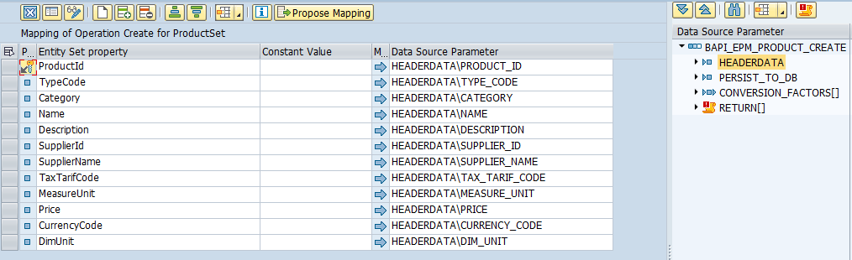
Building Create Entity Method
“BAPI_EPM_PRODUCT_CREATE” Use for Create Record.
01
Software Innovation
02
Hardware Innovation
Trainer: Anubhav Oberoy

Slide 16
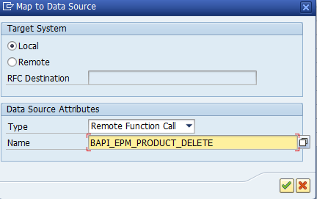
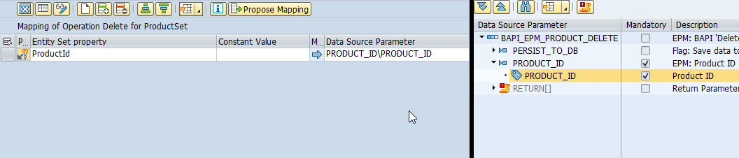
Building DELETE Entity Method
“BAPI_EPM_PRODUCT_DELETE” Use for Delete Record.
Introduction
01
Software Innovation
02
Hardware Innovation
Trainer: Anubhav Oberoy

Slide 17
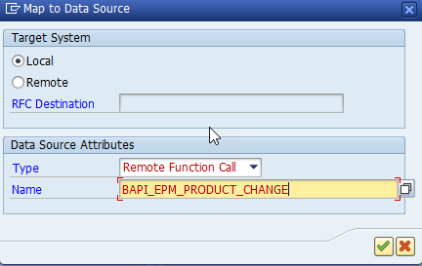
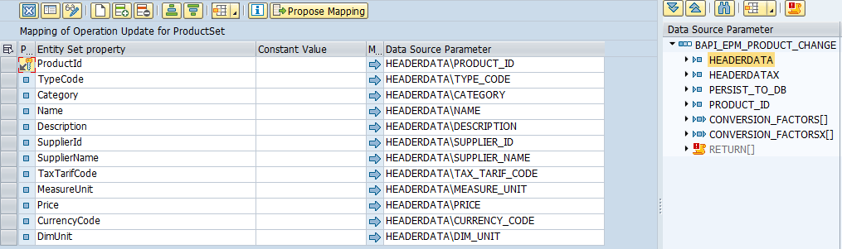
Building UPDATE Entity Method
“BAPI_EPM_PRODUCT_CHANGE” Use for Update Record.
Introduction
01
Software Innovation
02
Hardware Innovation
Trainer: Anubhav Oberoy

Slide 18
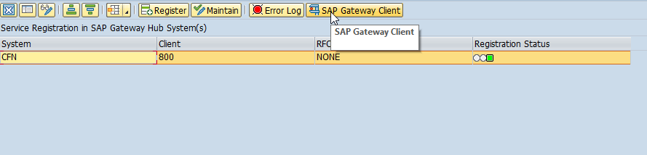
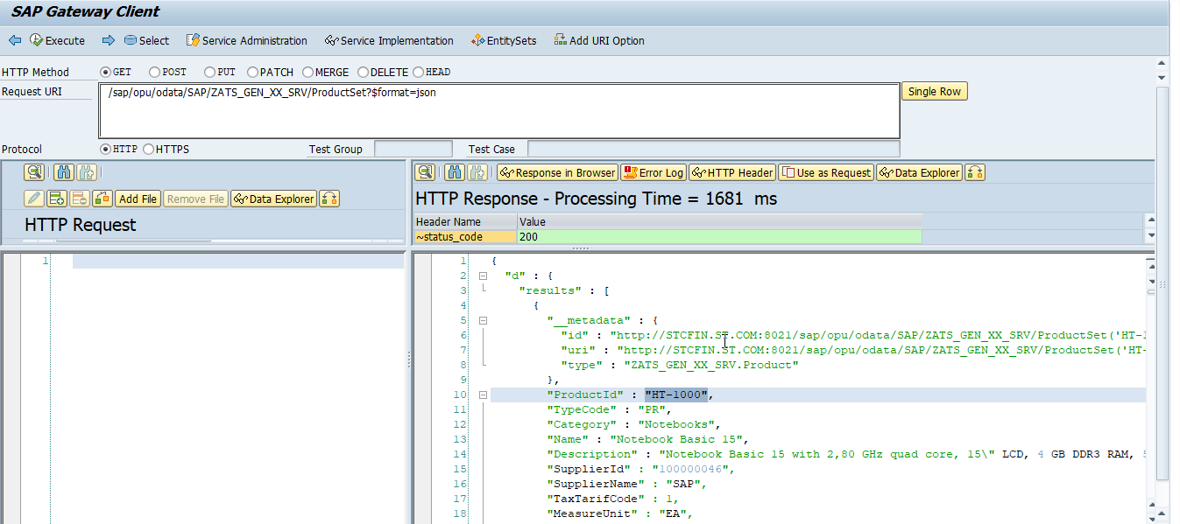
Test OData Service in Gateway Client
Introduction
01
Software Innovation
02
Hardware Innovation
Trainer: Anubhav Oberoy

Slide 19

Summarize
End of Day 9

Slide 20

Questions

Slide 21

ANUBHAV OBEROY
www.anubhavtrainings.com
THANK YOU
“You can never leave footprints that last if you are always walking on tiptoe.”
Notes:
https://pixabay.com/photos/men-employees-suit-work-greeting-1979261/

Slide 22


We’re committed to empower you to be
Most Desirable Resource
through powerful training solutions.
We build the workforce of the future.
250+
Corporate Clients
30,000+
Learners Trained
25000+
Learners Placed
FREE WEBINARS
Sign up for free webinars with industry experts every fortnight!
Enroll Now!
Contact us today!
https://anubhavtrainings.com/

Slide 23




More from AnubhavTrainings.com

